Slide 1
IMAGE TO TEXT CONVERTER
11 Abu Dujana -12010599
12 Adarsh Acharya -12010460
13 Priyanka Acharya -12010678
14 Shruti Adhau -12010962
15 Swapnil Adhav -12010355
Guide Prof. Kiran More

Slide 2
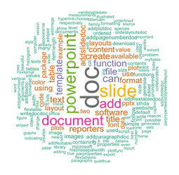
INTRODUCTION
Today the most information is available either on paper or in the form of scanned documents, Portable Document Formats (PDF).
To perform operations this information must be either in text format or editable format.
Writing down the information from an image can be very tedious, if the information is large.
Thus, there is a need for a system to extract text from general backgrounds.

Slide 3

ABSTRACT
The world is advancing to a futuristic paperless generation. Stockpiling of charters, records, big files and other documents has been drastically reduced. Storage of these documents as soft copy is more convenient and reliable. This makes searching and sorting very much easy. Generally such documents are stored as PDF, so as to make the documents easily viewable and avoid unnecessary changes due to software platforms. However, editing of locally scripted documents becomes inconvenient and hard. The conventional PDF to text conversion software are incapable of editing some unexplored scripts. In this project, a generic way of making PDF documents editable by the script-independent and machine learning features is presented. This is possible by slicing out the characters from the PDF. A set of classifiers is applied to identify characters. The Decision Model implemented as a part of Machine learning organizes the classifier functions. The resultant classifier set gives the resolution for the character. This approach removes the barrier of limiting our scope to international scripts and also facilitates usage of regional scripts in the technological world.

Slide 4
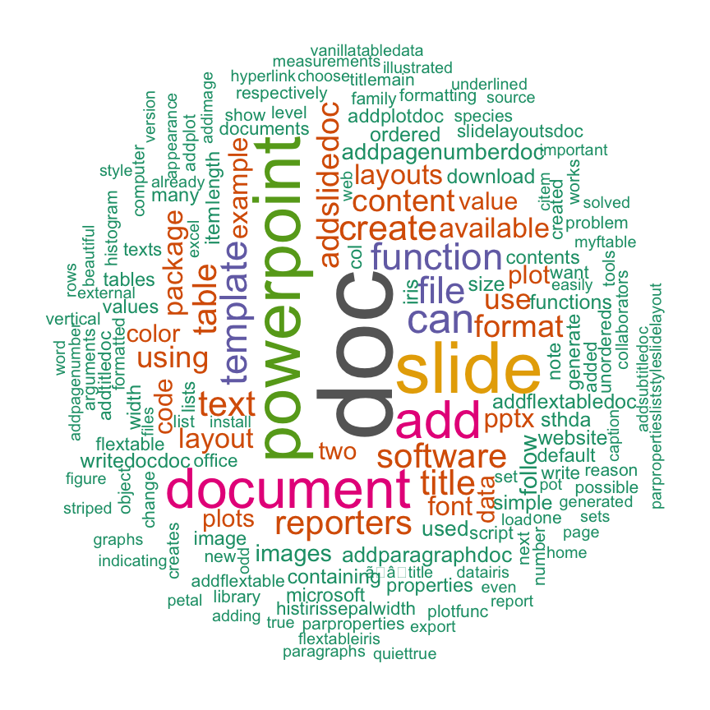
OBJECTIVES
To save our time we need something that extracts the data from the scanned documents in desirable format.
The objective of OCR software is to recognize the text and then convert it to editable form.
Thus, developing computer algorithms to identify the character in the text is the principal task of OCR.

Slide 5




TOOls
Python interpreter
Visual Studio Code
Machine Learning Algorithm
Python libraries

Slide 6
Optical character recognition
Image Processing
Pre-processing
Segmentation
Feature Extraction
Training a Neutral Network
Post-Processing

Slide 7
How ocr works
Every OCR works in 6 basic steps.
Image Acquisition: First, an image is scanned or captured and stored, then using image processing and image segmentation, it converts that image into black and white by replacing each pixel with a particular shade of black and white.
Pre-processing: To make the data readable for computers, the noise level of the image is optimized and the extra area around the texts is removed. This is especially vital when dealing with handwritten texts.
Segmentation: The image is then sliced line by line and then character by character to make them meaningful for the computer.

Slide 8
How ocr works
Feature extraction: This step means splitting the input data into a set of features, which means finding essential characteristics that make one or another pattern recognizable. As a result, each character gets classified in a particular class.
Training a Neural Network: Once all features are extracted, they are passed into a set of the neural network to train it to recognize different characters. The better the training data set is, the better the OCR works.
Post-processing: This part comes after the recognition of texts. If possible, few minor spelling errors get corrected.

Slide 9
Pseudo code
In the program, first, the features of each image get extracted, which means that a 2d image in png format undergoes various processes to convert each pixel into a list format. Then the extracted information goes to a function called knn, which stands for k nearest neighbors, this is the simplest machine learning algorithm to simply predict a given input. The more we train this function which is a set of neural networks, the better it predicts the given input. then finally the knn predicts the given text and returns the predicted value.

Slide 10

Future scope
Data conversion is an integral part of any business which requires converting one form of data into another useable format.
To overcome this problem, We can successfully use this and convert the data from one form to another easily. For e.g.: IMG to TEXT and it is more useful to convert PDF to TEXT, moreover Today the most information is available either on paper or in the form of scanned documents, Portable Document Formats (PDF).
The conventional PDF to text conversion software are incapable of editing some unexplored scripts.
In this project, a generic way of making PDF documents editable by the script-independent and machine learning features is presented. This is possible by slicing out the characters from the PDF.
This approach removes the barrier of limiting our scope to international scripts and also facilitates usage of regional scripts in the technological world.
This is how we can also convert regional scripts.

Slide 11
FLOWCHART
Taking file as input from user.
Converting and compressing the pages of file.
Declaring borders of images and resizing the generated images.
Generated images get cropped and are now ready for OCR.
All generated images get scanned by OCR and all texts are generated in one variable.
The generated texts undergo simple spelling check process to remove minor spelling mistakes.
The user is asked where to store the generated text, and the text is generated at desired format.
Finally, the generated images are deleted.

Slide 12
RESULT
In the end, user will get a text extraction from the pdf location that he/she had entered.
This project results in saving time of the user.
Tedious way of seeing and writing the information gets solved within just few clicks using this project.
All sort of typed information will be accurately converted to text format.
User gets to choose if he/she wants text on console or in the form of a text/word file.

Slide 13
REFERENCES
[1] Chandrahas Gaikwad,Satish Akolkar, Reshma Khodade, Deepali, Dalal
Swarupa Kamble - Generic PDF to Text Conversion using Machine Learning, International Journal of Computer Applications (0975 – 8887) Volume 106 – No. 12, November 2014.
[2] Noman Islam, Zeeshan Islam, Nazia Noor - A Survey on Optical Character Recognition System, Journal of Information & Communication Technology -JICT Vol. 10 Issue. 2, December 2016.
[3] Polaiah Bojja , Naga Sai Satya Teja Velpuri, Gautham Kumar Pandala,S D Lalitha Rao Sharma Polavarapu , Pamula Raja Kumari - Handwritten Text Recognition using Machine Learning Techniques in Application of NLP’(2019) ,International Journal of Innovative Technology and Exploring Engineering (IJITEE) ISSN : 2278-3075, Volume -9 Issue -2, December 2019.
[4] Nisha Pawar, Zainab Shaikh, Poonam Shinde, Prof. Y.P. Warke- Image to Text Conversion Using Tesseract, International Research Journal of Engineering and Technology, (IRJET) e-ISSN: 2395-0056 Volume: 06 Issue: 02| Feb 2019 www.irjet.net p-ISSN: 2395-007.

Slide 14
REFERENCES
[5] Sri. Yugandhar Manchala, Jayaram Kinthali, Kowshik Kotha, Kanithi Santosh Kumar, Jagilinki Jayalaxmi - Handwritten Text Recognition using Deep Learning with TensorFlow, International Journal of Engineering Research & Technology (IJERT) http://www.ijert.org ISSN: 2278-0181 IJERTV9IS050534 (This work is licensed under a Creative Commons
Attribution 4.0 International License.)Published by: www.ijert.org Vol.9 Issue 05, May 2020.
[6] JAMSHED MEMON, MAIRA SAMI, RIZWAN AHMED KHAN, MUEEN UDDIN - Handwritten Optical Character Recognition (OCR): A Comprehensive Systematic, Received June 24, 2020, accepted July 16, 2020, date of publication July 28, 2020, date of current version August 14, 2020. Digital Object Identifier 10.1109/ACCESS.2020.3012542.
[7] Tien Fui Yong, Saiful Azad,Mohammed Mostafizur Rahman, Kamal Z. Zamli - A Highly Accurate PDF-to-Text Conversion System for Academic Papers using Natural Language Processing Approach, Copyright © XXXX American Scientific Publishers Advanced Science Letters All rights reserved Vol. XXXXXXXXX Printed in the United States of America.

Slide 15
ANY QUESTIONS ?
THANKS!

